Slide 1
STATISTICS TRAINING
RAJESH KRISHNAN
30/09/2019

Slide 2
Table of Contents
Definition of Statistics
Population and Sample
Parameter and Statistic
Descriptive and Inferential Statistics
Statistical Data Analysis - Process Flow
Variables & Scales of measurement
Describing Data by tables and graphs
Measures of Central Tendency
Measure of Dispersion
Probability Distribution
Estimation - Point & Interval Estimates
Hypothesis Testing
Correlation
Cluster Analysis
Association Analysis
Regression Model
Classification Model
7-Step Predictive Modeling Process
Project Score Card – West Coast

Slide 3
Session 4:
Hypothesis Testing
T test
Testing for means and proportions
Power and confidence
A/B testing and sample size
Bayesian testing
Session 5:
Cluster Analysis
Common clustering algorithms
Kmeans clustering
Session 6:
Classification Model
Propensity modeling
Logistic regresson
Session7:
Trees
RF
Session 8:
Optimization and programming
Session 1
Definition of Statistics
Probability
Event, sample space
Population and Sample
Parameter and Statistic
Descriptive and Inferential Statistics
Conditional probability
Statistical Data Analysis
Variables & Scales of measurement
Measures of Central Tendency
Measure of Dispersion
Session 2:
Probability Distribution
PDF and CDF
Sampling distributions
Estimation - Point & Interval Estimates
Session 3:
Correlation
Regression

Slide 4
Definition of Statistics
Statistics is the methodology for collecting, organizing, presenting, summarizing, analyzing, interpreting and drawing conclusions from data.
It should be noted that statistics is much more than just the tabulation of numbers and the graphical presentation of these tabulated numbers.
Statistical methods can be used to ﬁnd answers to the questions like:
• What kind and how much data need to be collected?
• How should we organize and summarize the data?
• How can we analyze the data and draw conclusions from it?
• How can we assess the strength of the conclusions and evaluate their uncertainty?
Statistics provide methods for
1. Design: Planning and carrying out research studies
2. Description: Summarizing and exploring data
3. Inference: Making predictions and generalizing about phenomena represented by the data

Slide 5
Importance of Statistics & Applications
1) Statistics helps in collecting appropriate data.
2) Statistics helps in the proper and efficient planning of a statistical inquiry in any field of study.
3) Statistics helps in providing a better understanding and exact description of data.
4) Statistics helps in presenting complex data in a suitable tabular, diagrammatic and graphic form for easy and clear comprehension of the data.
5) Statistics helps in understanding the nature and pattern of variability of a phenomenon through quantitative observations.
6) Statistics helps in drawing valid inferences, along with a measure of their reliability about the population parameters from the sample data.

Slide 6
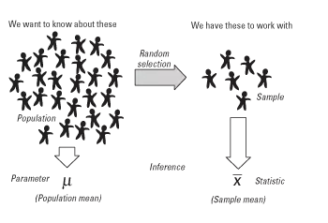
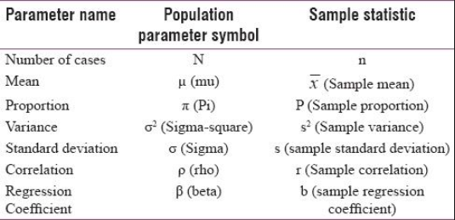
Population & Sample
Population: Population is the collection of all individuals or items under consideration in a statistical study
Parameter: Characteristic of a population is called parameter. In other words, any value that describes the population is called a parameter.
Sample: Sample is that part of the population from which information is collected, in simple terms, sample is a subset of population
Statistic: Characteristic of a sample is called statistic. In other words, any value that describes the sample is called a statistic.

Slide 7
Types of Sampling Techniques
In this case each individual is chosen entirely by chance and each member of the population has an equal chance, or probability, of being selected. One way of obtaining a random sample is to give each individual in a population a number, and then use a table of random numbers to decide which individuals to include
Simple random sampling
Individuals are selected at regular intervals from the sampling frame. The intervals are chosen to ensure an adequate sample size. If you need a sample size n from a population of size x, you should select every x/nth individual for the sample. For example, if you wanted a sample size of 100 from a population of 1000, select every 1000/100 = 10th member of the sampling frame.
Systematic sampling
In this method, the population is first divided into subgroups (or strata) who all share a similar characteristic. Stratified sampling improves the accuracy and representativeness of the results by reducing sampling bias.
Stratified sampling

Slide 8
Descriptive & Inferential Statistics
STATISTICS
Product Fatigue - Understanding key drivers for Product Fatigue
Brand Perception Map - Creating a brand perception mapping for key trends
GOOGLE
REVLON
DESCRIPTIVE STATISTICS
INFERENTIAL STATISTICS
Descriptive statistics consist of methods for organizing and summarizing information
Includes the construction of graphs, charts, tables, and the calculation of various descriptive measures such as averages, measures of variation, and percentiles
Inferential statistics consist of methods for drawing and measuring the reliability of conclusions about population based on information obtained from a sample
Includes point estimation, interval estimation and hypothesis testing
Descriptive and Inferential statistics are interrelated. It is always necessary to use methods of descriptive statistics to organize and summarize the information obtained from a sample before methods of inferential statistics can be used to make more thorough analysis of the subject under investigation

Slide 9
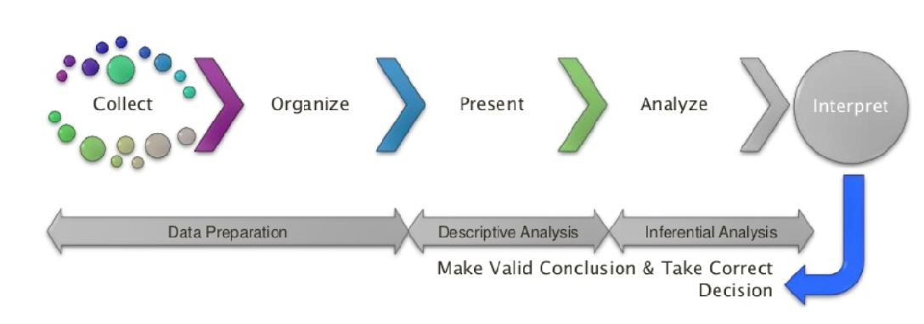
Statistical Data Analysis - Process Flow
Use appropriate statistical method to solve the research problem
Report the Results
END
Formulate the research problem
Define population and sample
Collect the data
Do Descriptive Analysis
BEGIN
Product Fatigue - Understanding key drivers for Product Fatigue
GOOGLE
REVLON
PAYPAL
To conclude this section, we can note that the major objective of statistics is to make inferences about population from an analysis of information contained in sample data

Slide 10
Variables & Types
What is a Variable?
A characteristic that varies from one person or thing to another is called a variable, i.e., a variable is any characteristic that varies from one individual member of the population to another.
Discrete (Count variable)
No of students present
No of heads in coin toss
Quantitative variable
Types of Variables?
Continuous (By Measure)
Height
Weight
Time taken
Distance covered
Qualitative variable
Gender
Marital Status

Slide 11
Scales of Measurement
Nominal
If the categories of a qualitative variable are unordered, then the qualitative variable is said to be deﬁned on a nominal scale, the word nominal referring to the fact that the categories are merely names
Gender, Marital Status are some of the examples
Ordinal
If the categories can be put in order, the scale is called an ordinal scale. Every value has a unique meaning
Example of Ordinal scale is Clothing size (S,M,L), Attitudes (Strongly Agree, Agree, Neutral, Disagree, Strongly Disagree)
Interval
The interval scale of measurement is a type of measurement scale that is characterized by equal intervals between scale units.
Temperature is on the interval scale: a difference of 10 degrees between 90 and 100 means the same as 10 degrees between 150 and 160. If meaningful divisions are possible, the data is on a interval scale.
Ratio
A ratio scale is an interval scale with a meaningful absolute zero point.
For example, temperature measured on the Centigrade system is a interval variable and the height of person is a ratio variable.

Slide 12
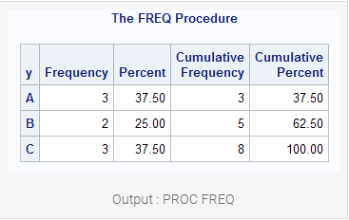
Describing Data by Tables & Graphs
Frequency - The number of observations that fall into particular class (or category) of the qualitative variable is called the frequency (or count) of that class.
Frequency Distribution - A table listing all classes and their frequencies is called. a frequency distribution

Slide 13
Describing Data by Tables & Graphs (contd…) – Class Intervals
The data of quantitative variable can also presented by a frequency distribution. If the discrete variable can obtain only few diﬀerent values, then the data of the discrete variable can be summarized in a same way as qualitative variables in a frequency table.
If the discrete variable have a lot of diﬀerent values or the quantitative variable is the continuous variable, then the data must be grouped into classes (categories) before the table of frequencies can be formed.
The main steps in a process of grouping quantitative variable are:
1) Find the minimum and the maximum values of variable in the data
2) Choose intervals of equal length that cover the range between the minimum and the maximum without overlapping. These are called CLASS INTERVALS, and their end points are called CLASS LIMITS
3) Count the number of observations in the data that belongs to each class interval. The count in each class is the CLASS FREQUENCY.
Notes:
Explain with an example
0-10, 10-20, 20-30….,90-100 → with counts for each

Slide 14
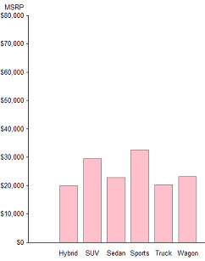
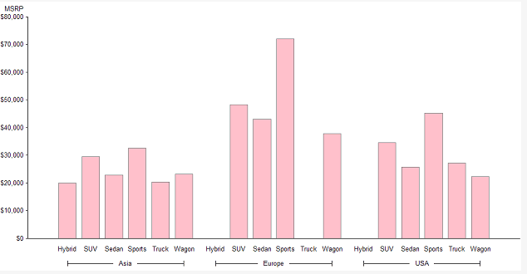
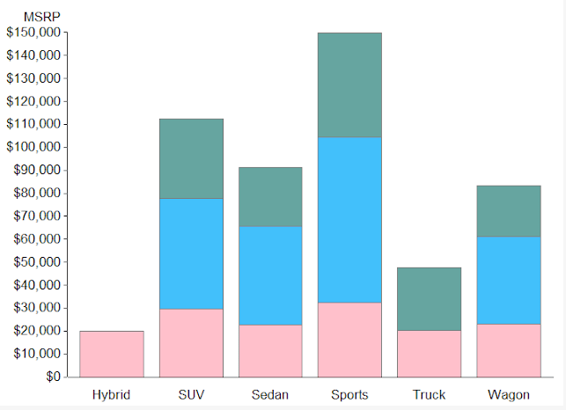
Describing Data by Tables & Graphs (contd…) – Bar Charts
Vertical Bar Chart
Grouped Bar Chart
Stacked Bar Chart
Other types of Bar charts are: Sorted Bar chart, Horizontal Bar chart, Percentage Bar chart
Notes:
`

Slide 15
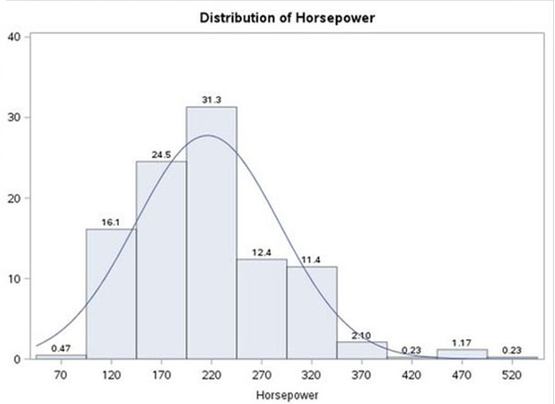
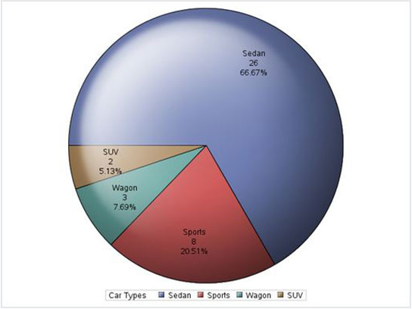
Describing Data by Tables & Graphs (contd…) – Pie Chart & Histogram
Grouped Bar Chart
Stacked Bar Chart
A histogram is an accurate representation of the distribution of numerical data. It is an estimate of the probability distribution of a continuous variable
A pie-chart is a representation of values as slices of a circle with different colors. The slices are labeled and the numbers corresponding to each slice is also represented in the chart.
Notes:
`

Slide 16
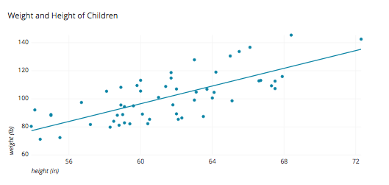
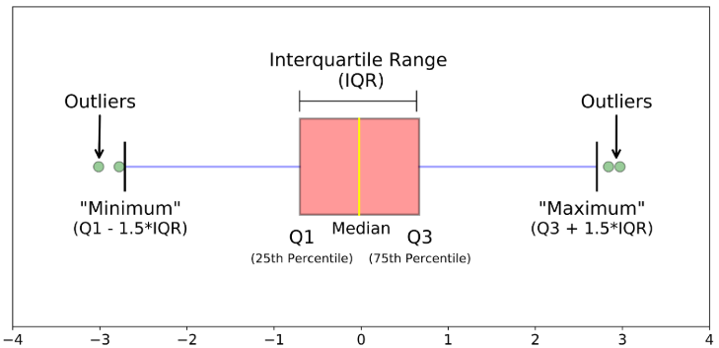
Describing Data by Tables & Graphs (contd…) – Scatter plot & Box plot
A scatter plot is a two-dimensional data visualization that uses dots to represent the values obtained for two different variables - one plotted along the x-axis and the other plotted along the y-axis.
In descriptive statistics, boxplot is a method for graphically depicting groups of numerical data through their quartiles. It may also have lines extending vertically from the boxes (whiskers) indicating variability outside the upper and lower quartiles
Grouped Bar Chart
Stacked Bar Chart

Slide 17
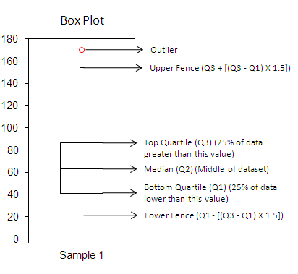
Describing Data by Tables & Graphs – How to read a Box plot
A box plot shows the distribution of data. It is useful in visualizing skewness in data
Normal Distribution or Symmetric Distribution : If a box plot has equal proportions around the median, we can say distribution is symmetric or normal.
Positively Skewed : For a distribution that is positively skewed, the box plot will show the median closer to the lower or bottom quartile.
Negatively Skewed : For a distribution that is negatively skewed, the box plot will show the median closer to the upper or top quartile.
Outlier : If a value is higher than the 1.5*IQR above the upper quartile (Q3), the value will be considered as outlier. Similarly, if a value is lower than the 1.5*IQR below the lower quartile (Q1), the value will be considered as outlier.
Boxplot is usually better for comparing distributions between several groups or data sets

Slide 18
Measures of Central Tendency
It is affected by extreme values. Very large or very small numbers can distort the answer
MEAN
(Average Value) It is the sum of the observations divided by the sample size.
Easy to understand & calculate
Saves time
It does not take into account the precise value of each observation and hence does not use all information available in the data
MEDIAN (Middle value) Half of the data are above the median; half of the data are below the median.
It is NOT affected by extreme values. Very large or very small numbers does not affect it
There may be no mode at all if none of the data is the same
There may be more than one mode
MODE
It is the value that occurs most frequently in a dataset
It can be used when the data is not numerical
Notes:
Measures of Central Tendency – Representative of the data or the value that best describes the data

Slide 19
When to use each measure of Central Tendency
MEAN is the most frequently used measure of central tendency.
However, there are some situations where either median or mode are preferred
MEDIAN is the preferred measure of central tendency when:
There are a few extreme scores in the distribution of the data. (NOTE: Remember that a single outlier can have a great effect on the mean)
There are some missing or undetermined values in your data
There is an open ended distribution (For example, if you have a data field which measures number of children and your options are 0, 1, 2, 3, 4, 5 or “6 or more,” then the “6 or more field” is open ended and makes calculating the mean impossible, since we do not know exact values for this field)
MODE is the preferred measure when data are measured in a nominal (and even sometimes ordinal) scale

Slide 20
Measures of Dispersion
Measure | Definition
Range | It is the largest observation minus the smallest observation
Standard Deviation | It is a measure of spread of data about the mean
Skewness | It is a measure of symmetry. A distribution is symmetric if it looks the same to the left and right of the center point
Kurtosis | It is a measure of whether the data are peaked or flat relative to the rest of the data Higher values indicate a higher, sharper peak; lower values indicate a lower, less distinct peak
Notes:
It refers to the spread or dispersion of data points

Slide 21
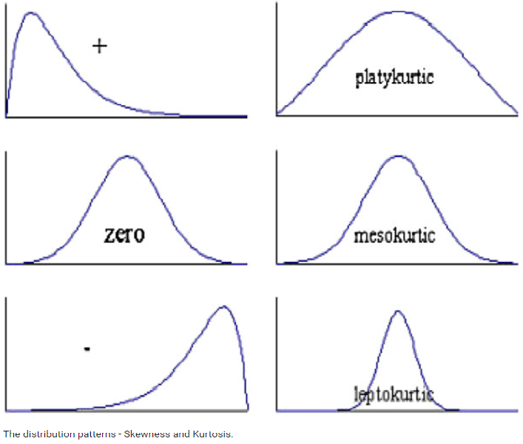
Measures of Dispersion – Some examples
SKEWNESS
KURTOSIS
Notes:
It refers to the spread or dispersion of data points

Slide 22
Summary Statistics - Examples
Notes:
Go to Excel for Example

Slide 23


An Introduction
Thank You
Actionable Insights. Accurate Decisions

